Slide 1

How Smartly Erlang Uses Distributed Computing
MANDEEP SINGH
T120224226 & 3323

Slide 2


MOTIVATION
EVER WONDERED HOW A TEAM OF JUST 55 ENGINEERS MANAGES BILLIONS OF USERS ON THEIR CHATTING PLATFORM?

Slide 3
ERLANG
THE ANSWER
1

Slide 4
DISTRIBUTED COMPUTING
Its field of computer science that studies about distributed systems.

Slide 5
DISTRIBUTED SYSTEMS
It is a model in which various components of networked system interact and coordinate their actions by passing messages.

Slide 6
There is difference between distributed computing and parallel computing!

Slide 7

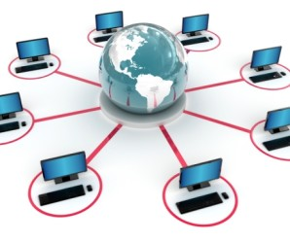
SYSTEM REQUIREMENTS
CONCURRENCY
CONTINUOUS OPERATION
SOFT REAL-TIME
COMPLEX FUNCTIONALITY
HARDWARE INTERACTION
FAULT TOLERANCE

Slide 8
1
Concurrency
ERLANG
DESIGN
2
Error Encapsulation
3
Fault Detection
4
Code Upgrade
5
Stable Storage

Slide 9
OVERVIEW OF ERLANG
Everything in Erlang is process.
Processes are strongly isolated.
Process creation and destruction is light weight process.
Message Passing is the only way processes can interact.
Processes are identified by Pids.
Processes share no resources.

Slide 10
ERLANG PROCESSES vs OS THREADS
Implemented in Erlang VM.
Dynamic allocation.
Single threaded.
Implemented at OS level.
Static allocation
Multithreaded.

Slide 11
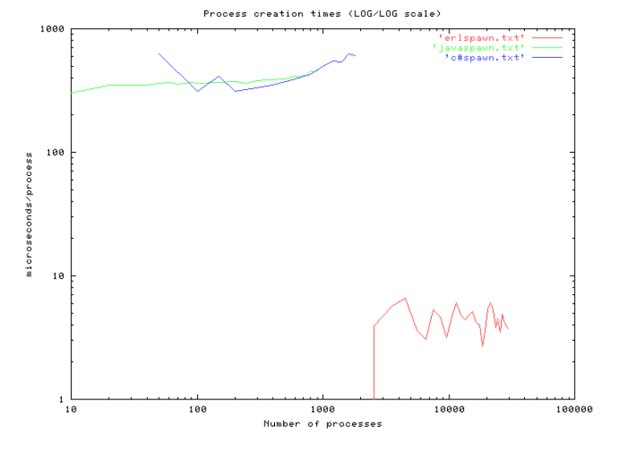
COMPARISON OF ERLANG PROCESSES

Slide 12
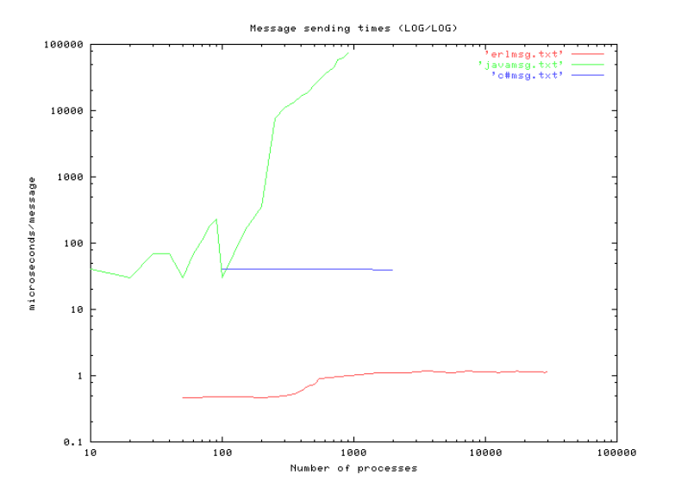
COMPARISON OF MESSAGE PASSING

Slide 13
WHATSAPP STATS
1.2 BILLION MONTHLY ACTIVE USERS AND 50 BILLIONS MSGS EVERY DAY
>70 MILLION ERLANG MESSAGES PER SECOND
$0 INVESTED IN ADVERTISEMENT
DUAL WESTMERE HEX-CORE, 100 GB RAM, FREEBSD, OTP R14B03

Slide 14

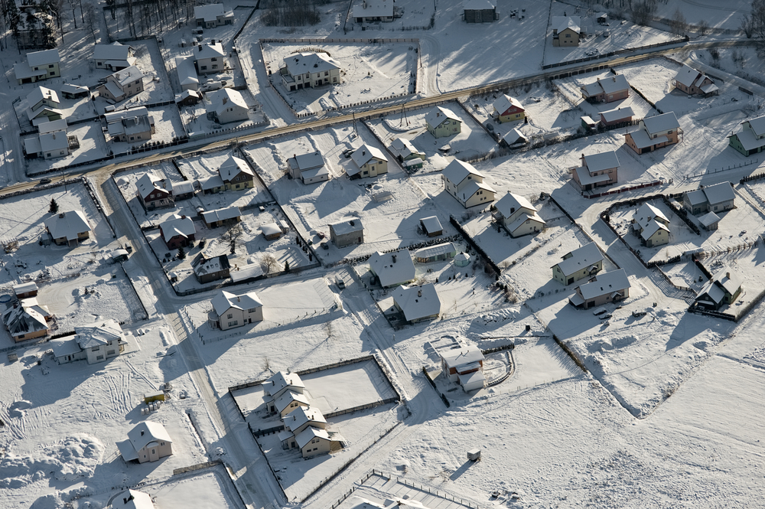
THE PROBLEM SOLUTION
WHATSAPP server has been started from ejabberd.

Slide 15
BACKEND IMPLEMENTATION
Ejabberd is open source Jabber server written in Erlang.
To handle huge amount of messages, focus is reliable system.
Almost every day, some new code is pushed, Erlang hot loading of code helps a lot in this.
All messages are queued on server until client reconnect and retrieve the messages.
>11,000 cores run on Erlang system.

Slide 16
WORK DISTRIBUTION
Need to distribute over 11,000 nodes.
A basic single threaded gen_server is implemented.
>85 % CPU utilization across logical CPUs.

Slide 17
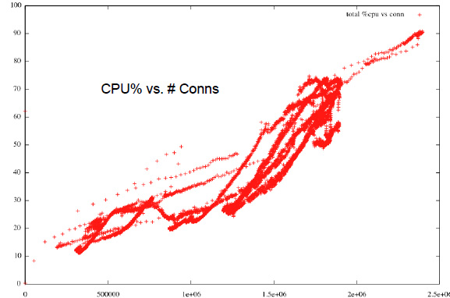

Slide 18


ERLANG DATABASE
MNESIA
ETS(Erlang Term Storage)
INMEMORY DATABASE, STORE LARGE QUATITIES OF DATA IN ERLANG RUN-TIME SYSTEM, used for caching.
DISTRIBUTED AS A PART OF OTP(build on top of ETS), USED FOR SECONDARY STORAGE.

Slide 19

CONCLUSION
ERLANG IS BEST SUITED FOR BACKEND DEVELOPMENT OF MESSAGING PLATFORMS.

Slide 20


Slide 21
THE END

